Slide 1
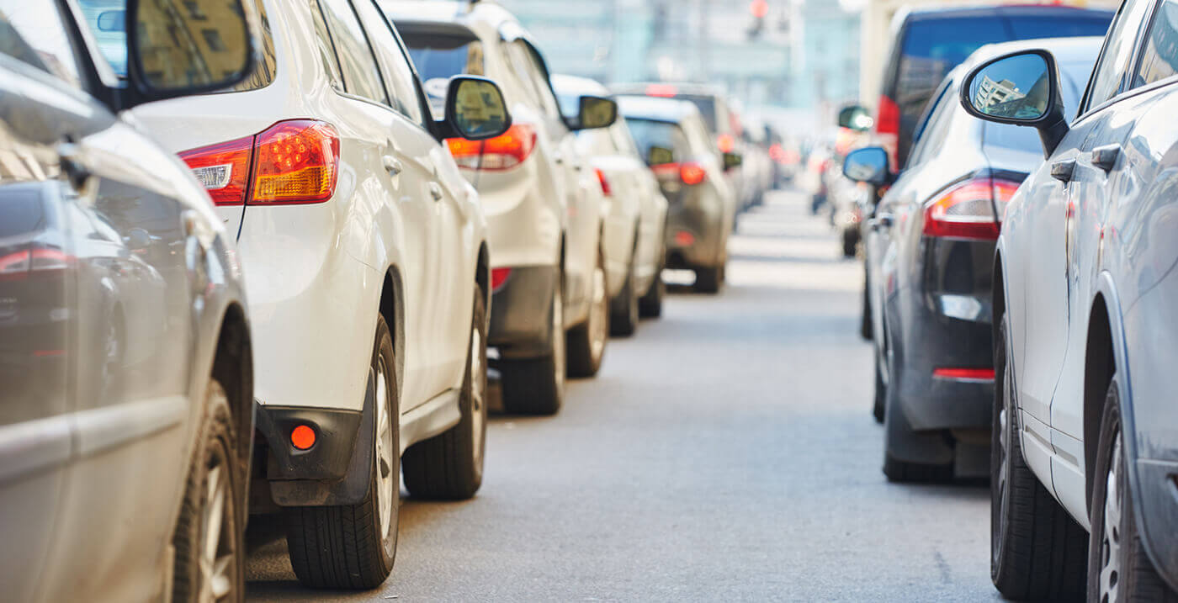
TRAFFIC & TRAVEL RESEARCH 2023

Slide 2
TRAFFIC & TRAVEL RESEARCH 2023
Three stage research plan
Stage 1 : Large scale quantitative study
General investigation of traffic and travel information sources, usage, occasions, attitudes and opinions
2,000 listeners (via online panel in March 2023)
Nationally representative
Repeat of original research from November 2016
Stage 2 : Short, sharp quantitative survey to smartphones
Reflect immediacy, based on that days experience
250 listeners (via online panel to smartphones in March 2023)
Nationally representative, 50 per day across a 5 day working week
All surveys completed between 10am and 7pm on the day
Repeat of original research from November 2016
Stage 3 : Qualitative survey
Provide a short narrative around experiences of traffic and travel information sources
100 listeners (via online panel in March 2023)

Slide 3
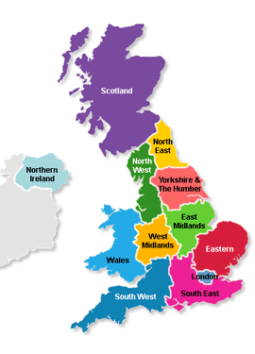
TRAFFIC & TRAVEL RESEARCH 2023
STAGE 1
STAGE 2
STAGE 3
 | % popn.
North East | 4
North West | 11
Yorkshire and the Humber | 8
East Midlands | 7
West Midlands | 9
East of England | 9
London | 13
South East | 14
South West | 8
Wales | 5
Scotland | 8
Northern Ireland | 3
Base: 2,002
Base: 260
Base: 100
STAGE 1
4
11
9
7
9
9
13
14
8
5
8
3
4
10
9
7
9
8
14
15
9
5
8
3
5
10
9
8
9
8
16
16
7
4
8
0
4
11
6
9
9
7
15
16
9
4
8
2
50%/50% Male/Female
50%/50% Male/Female
51%/49% Male/Female
40%/39%/21% 16-34/35-54/55+
41%/41%/19% 16-34/35-54/55+
38%/42%/20% 16-34/35-54/55+

Slide 4
TRAFFIC & TRAVEL INFORMATION SOURCES - 1
Q When thinking of daily traffic and travel updates, particularly in the morning and early evening, which sources of up-to-the-minute information are you aware of?
Radio is the most significant source of traffic and travel updates
that comes to mind spontaneously.
%
(Apple Maps, Waze, etc)
(Facebook, Twitter, Tik Tok, etc)
%
(unspecified)
(Amazon Echo/Alexa)
Stage 1 2016 2023

Slide 5
TRAFFIC & TRAVEL INFORMATION SOURCES - 2
Q When thinking of daily traffic and travel information, which of these up-to-the-minute sources are you aware of?
Offering a list of potential sources produces far greater awareness of others,
however radio remains ahead of the field.
%
%
n/a
n/a
n/a
Stage 1 2016 2023

Slide 6
TRAFFIC & TRAVEL INFORMATION SOURCES - 3
Q Which have you ever used for traffic and travel information whilst you are commuting or travelling locally?
Whilst the use of Google Maps has increased significantly,
radio remains the single most used source of traffic and travel information.
%
%
n/a
n/a
n/a
Stage 1 2016 2023

Slide 7
TRAFFIC & TRAVEL UPDATES IN THE MORNING - 1
Q When you’re getting ready in the morning, how do you get your traffic and travel updates?
Seven in ten listeners will get traffic and travel updates from the radio as part of
their morning routine, significantly ahead of other sources.
%
Stage 1 2016 2023

Slide 8
TRAFFIC & TRAVEL UPDATES IN THE MORNING - 2
Q When you’re getting ready in the morning, how do you get your traffic and travel updates?
When listeners are thinking about their actual behaviour on a particular day, the popularity of radio updates
is more widespread, whereas actual use of other sources drops back significantly.
%
2023 Stage 1 Stage 2

Slide 9
TRAFFIC & TRAVEL UPDATES IN THE MORNING - 4
Q When you’re getting ready in the morning, how do you get your traffic and travel updates and why?
Usually from the local radio stations i.e. Capital, Heart or Radio Wales. These stations are local to my area here in South Wales.
I wake up to local radio and this gives me the traffic reports I need. For any other traffic I might use Waze for a journey.
Always listen to local radio stations. Prefer to listen to radio whilst getting ready. Do not trust social media.
I usually get it from the radio updates but when I make a journey that isn't usual or a bit long I check the map apps on my phone.
From the radio. I can carry on getting ready for work without visual distraction.
Initially listen to the local radio, and if I have any concerns I would check on a travel website.
From radio, whilst getting into my work wear. For ease.
I turn on the radio and that is the main source of traffic information. My GPS also alerts me if there are delays on my route, such as works or accidents.
I listen to the radio for any updates as they are always correct. Nextdoor app is also a good update for local roads.
2023 Stage 3

Slide 10
TRAFFIC & TRAVEL UPDATES IN THE CAR - 1
Q When you’re in the car, how do you get your traffic and travel updates?
The vast majority of listeners rely on radio for their traffic and travel updates when they’re in the car.
%
Stage 1 2016 2023

Slide 11
TRAFFIC & TRAVEL UPDATES IN THE CAR - 2
Q When you’re in the car, how do you get your traffic and travel updates?
By looking at behaviour on a particular day, it becomes clear radio is by far the main source of traffic
and travel information whilst other sources are used on a much more occasional basis.
%
2023 Stage 1 Stage 2

Slide 12
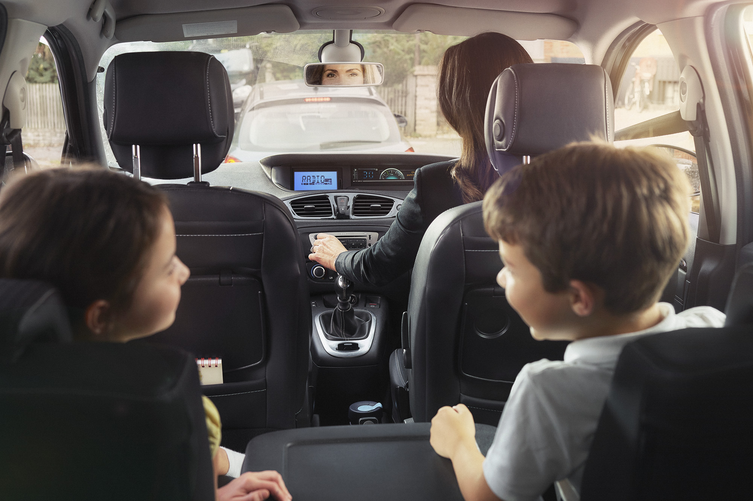
TRAFFIC & TRAVEL UPDATES IN THE CAR - 4
Q When you’re in the car, how do you get your traffic and travel updates?
Radio, because I am listening to it anyway.
I prefer to hear radio bulletins as it’s much more practical when I am driving, it’s not possible to look at a map and manage a steering wheel at the same time.
Mostly from the radio. I tend to use a local station to wherever I am. But also my satnav will give me alerts if there are route issues.
From a national radio station that does local traffic updates in the morning every 20 minutes, longer journeys would again be through the radio, unless I have a passenger who can check travel apps or social media.
Either the radio would give regular updates or the map app I use would show areas of red traffic on my journey.
From the radio when I’m driving. I don’t have the time to check other means.
I rely on local radio and roadside boards as it's illegal to look at my phone whilst driving.
From the radio while driving or information boards if I use the motorway. Using phone or maps could prove dangerous.
I listen to the radio for updates. Also look at route directions boards if there are roadworks.
2023 Stage 3

Slide 13
TRAFFIC & TRAVEL UPDATES IN THE CAR - 5
Q When you are listening to the radio in the car, do you ever turn the radio up when…?
In the car, most listeners will turn the radio up when a favourite song or tune comes on
and a large proportion will do so when there’s a traffic and travel bulletin or when the news comes on.
%
Stage 1 2016 2023

Slide 14
ELEMENTS OF A FAVOURITE RADIO STATION - 1
Q When you think of all the things that make up your favourite radio station, apart from the presenters, music and the main programmes, how important are each of these elements?
Traffic and travel reports are seen as an important part of a favourite radio station by seven in ten listeners.
%
Stage 1 2016 2023

Slide 15
ELEMENTS OF A FAVOURITE RADIO STATION - 2
Q When you think of all the things that make up your favourite radio station, apart from the presenters, music and the main programmes, how important are each of these elements?
Q How important is it that your radio station has Traffic & Travel bulletins?
When listeners focus on the traffic and travel bulletins they got on a particular day,
a near eight in ten listeners will say they have been important.
%
Stage 1 2016 2023
2023 Stage 2

Slide 16
SWITCH RADIO STATIONS TO GET TRAFFIC & TRAVEL - 1
Q If the radio station you were listening to before you were about to travel or whilst you were travelling, did not have up-to-the-minute traffic and travel bulletins, how likely are you to
look for a radio station that does have up-to-the-minute traffic and travel bulletins?
A large proportion of listeners will actively look for a station
giving them traffic and travel reports.
48%
43%
%
Stage 1 2016 2023

Slide 17
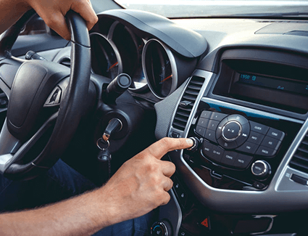
SWITCH RADIO STATIONS TO GET TRAFFIC & TRAVEL - 2
Q In a recent survey, a surprising number of people told us that if the radio station they were listening to before they were about to travel or whilst they were travelling, did not have
up-to-the-minute traffic and travel bulletins, they would probably look for a radio station that does have up-to-the-minute traffic and travel bulletins. Would you?
I would but only if the trip is of a certain distance and especially if driving in an area I am not familiar with so do not know the roads well enough to get around any delays.
It’s better to be aware of any delays while travelling so I would too, I'd skip to another station.
Yes. Because of my work I need to be kept updated on any new traffic situations.
If the station I was listening to had no traffic updates while I was on a journey then yes, I would most definitely find another station
Yes important to have a radio station that gives you travel updates on your journey to work.
It's not important to me for my short journey but would be if travelling further.
Yes, because the travel reports are an important part of my commute.
Yes as this would enable me to be aware of anything that could affect my journey. I could then plan or amend my journey accordingly, let people know I might be late, etc.
On a long journey then yes I definitely would look for another station. This is when I would really want up to the minute travel information.
2023 Stage 3

Slide 18
COMPARISON ACROSS SOURCES OF TRAFFIC AND TRAVEL INFORMATION - 1
Q Which of these sources of traffic and travel information would you say is the most…?
Traffic and travel bulletins on the radio are seen as the most accurate
and reliable which makes them the most trustworthy and the most useful.
Google Maps
Maps
Waze
Citymapper
%
Stage 1 2023 Radio Apps Social media

Slide 19
COMPARISON ACROSS SOURCES OF TRAFFIC AND TRAVEL INFORMATION - 2
Q How would you compare the radio traffic and travel bulletins with sources like maps on your smartphone or travel information you might get on social media?
Much prefer audio sources e.g. radio, than phones or map apps. SatNav information quite often out of date.
In real time and regular. I trust what I hear on the radio.
Traffic information on smart phones are good before you start your journey, but instant warning of congestion during important times of the day, like radio gives you, are vital.
Local radio travel updates are just as good as Google Maps updates. I do not use social media for travel updates
Radio bulletins are in real time and are usually very accurate. Also, they are a lot safer and easier to use than a smartphone when travelling.
Rarely use phone or apps. Rely on SatNav for route then check on radio whilst on the route on a longer journey. If going on a short or familiar route, again I depend on radio bulletins.
When driving I can get the information without taking my eyes off the road.
Radio and smart phone sat nav are the two main sources. In the morning before leaving I do use browser but that's it. Evening is all down to radio
It's just easier to listen to updates rather than looking through your phone.
No need to search for information, given as part of the (radio) programmes routine.
2023 Stage 3

Slide 20
TRAFFIC & TRAVEL RESEARCH 2023
RADIO TRAFFIC & TRAVEL BULLETINS REMAIN THE MOST WIDELY USED AND MOST OFTEN USED SOURCE OF TRAFFIC & TRAVEL INFORMATION, WITH RELIABILITY AND ACCESSABILITY KEY FACTORS.
70% will get their traffic and travel info from the radio when they’re getting ready in the morning
84% will get their traffic and travel info from the radio when they’re in the car
75% will turn the radio up when traffic and travel comes on
TRAFFIC & TRAVEL BULLETINS ARE SEEN AS AN IMPORTANT PART OF A RADIO STATION’S CONTENT.
70% think the traffic and travel bulletins are an important part of their favourite radio station
56% say they prefer to listen to a radio station that has traffic and travel bulletins
43% are likely to look for an alternative station if the one they’re listening to doesn’t have traffic and travel updates

Slide 21
THANK YOU

