Slide 1
2022

Slide 2
radio

Slide 3
“reaching 75% of commercial radio’s weekly listeners…”
NATIONAL COVERAGE
240 radio stations across the UK covering all major conurbations
REACH & FREQUENCY
Reaching over 28.2 million adults each week, 642 ratings. That’s 75% of commercial radio’s weekly listening.
HIGHER ENGAGEMENT
With 48% higher ad recall this is the stand-out your brand needs, directly next to “appointment-to-listen” content.
BREAKFAST, MORNING, AFTERNOON, DRIVE
All advertising is positioned within key radio listening times for maximum reach.
48%
HIGHER AD RECALL THAN THAT OF A STANDARD AD BREAK
Source: Clark Chapman research
Source: RAJAR Q3 2022

Slide 4
WALES & WEST
106.3 Bridge FM
96.4 FM The Wave
Capital South Wales
Dragon Radio
Greatest Hits (Bristol & Bath)
Greatest Hits (Devon)
Greatest Hits (Dorset)
Greatest Hits (Gloucestershire)
Greatest Hits (Plymouth)
Greatest Hits (South Coast)
Greatest Hits (South Wales)
Greatest Hits (Swindon)
Greatest Hits Radio (Cornwall)
Haven Radio
Heart North WALES
Heart South WALES
Heart South West
Heart West COUNTRY
Hits Radio (Bristol & South West)
Jack 2 Hits Oxfordshire
Jack 3 Chill
JACK FM (Oxford)
KFM (West)
Kiss (West)
Nation Radio Ceredigion
Nation Radio Wales
Pirate FM
Radio Carmarthenshire
Smooth Radio Devon
Smooth Radio North West and Wales
Smooth Radio South Wales
Smooth Radio West Country
Breezy Radio (Wales)
EAST OF ENGLAND
Gold Cambridgeshire
Greatest Hits (Essex)
Greatest Hits (Great Yarmouth)
Greatest Hits (Ipswich)
Greatest Hits (North Norfolk)
Greatest Hits (Norwich)
Greatest Hits (West Norfolk)
Heart Cambridgeshire
Heart East Anglia
Heart Essex
Heart Four Counties (Milton Keynes)
GHR (Suffolk)
KFM (East)
Kiss (East)
Smooth Radio Cambridgeshire
Smooth Radio East Anglia
Smooth Radio Essex
Star Radio (Cambridge and Ely) (NR)
Total Radio Essex
NATIONAL/DIGITAL
Absolute 80s
Absolute Classic Rock
Absolute Radio
Absolute Radio 00s
Absolute Radio 90s
Absolute Radio Country
Boom Radio – DAB Trading
Capital London Plus
Gold London Plus
Heart London Plus
Radio X London Plus
Smooth Radio London Plus
Classic FM UK (Digital)
Greatest Hits Radio
Heart 80s
Heat
Hits Radio
Jazz FM
Kerrang!
Kiss
Kiss FRESH
KissTORY
LBC (UK)
LBC News (Uk)
Magic
Magic Chilled
Magic Soul
Mellow Magic
Nation Radio UK
Planet Rock
Scala Radio
talkRadio
talkSPORT
talkSPORT2
Virgin Anthems
Virgin Chilled
Virgin Radio
SOUTH & SOUTH EAST
Capital Brighton
Capital South Coast
Classic FM (South)
Greatest Hits (East Hampshire)
Greatest Hits (Berkshire & North Hampshire)
Greatest Hits (Salisbury)
Greatest Hits (Somerset)
Greatest Hits (South Coast)
Greatest Hits (Surrey & East Hampshire)
Greatest Hits (West Norfolk)
Greatest Hits (West Sussex)
Heart Four Bounties Bedfordshire)
Heart Four Counties
Heart Kent
Heart Solent
Heart SUSSEX
Heart THAMES VALLEY
Hits Radio (Bournemouth & Poole)
IOW Radio
More Radio
Smooth Radio Kent
Smooth Radio Solent
Smooth Radio Sussex
Smooth Radio Thames Valley
Wave 105
LONDON
Absolute Radio
Capital London +
Classic FM London
Gold London
Greatest Hits (London)
Heart London
Kiss London
Lyca Gold
Lyca Radio 1458am
Magic London
Mi-Soul
Radio X London
Smooth London
Time FM 107.5

Slide 5
NORTH WEST
C.F.M
Capital Lancashire
Capital Liverpool
Capital Manchester
Capital North West & Wales
Cheshire's Silk 106.9
Chesters Dee 106.3 (Dee on DAB)
Hits Radio (Manchester)
Greatest Hits (Blackpool)
Greatest Hits (Bolton)
Greatest Hits (Lancashire)
Greatest Hits (Liverpool)
Greatest Hits (Manchester)
Greatest Hits (Warrington)
Greatest Hits (Wigan & St Helens)
Heart North Lancs & Cumbria
Heart North West
Love 80s Liverpool
Radio City
Radio X Manchester
Rock FM
Smooth Lake District
Smooth North West
XS Manchester
MIDLANDS
Capital Birmingham
Capital East Midlands
Capital Mid Counties
Classic FM Midlands
Greatest Hits (Bucks, Beds & Herts)
Greatest Hits (Black Country & Shropshire)
Greatest Hits Radio (Coventry & Warwickshire)
Greatest Hits Radio (East Midlands)
Greatest Hits Radio (Herefordshire and Worcestershire)
Greatest Hits (North Derbyshire)
Greatest Hits (Staffordshire & Cheshire)
Greatest Hits Radio (West Midlands)
Free Radio FM (Coventry & Warwickshire)
Free Radio FM (Herefordshire & Worcestershire)
Gem
Gold East Midlands
Heart West Midlands
Signal One
Smooth East Midlands inc. Connect FM
Smooth West Midlands
Smooth Three Counties
YORKSHIRE
Capital Yorkshire
Greatest Hits (Barnsley)
Greatest Hits (Bradford & West Yorkshire)
Greatest Hits (Doncaster)
Greatest Hits (Harrogate & Yorkshire Dales)
Greatest Hits Radio (Hull & East Yorkshire)
Greatest Hits Radio (Lincolnshire Grimsby Stamford & Rutland)
Greatest Hits Radio (Leeds & West Yorkshire)
Greatest Hits (Rotherham)
Greatest Hits Radio (South Yorkshire)
Greatest Hits (York & North Yorkshire)
Greatest Hits (Yorkshire Coast)
Greatest Hits (Wakefield)
Lincs FM 102.2
Hallam FM
Heart Yorkshire
KCFM
PULSE 1
Viking FM
Greatest Hits (North Yorkshire)
SCOTLAND
Capital Scotland
Central FM
Classic FM (Scotland)
Clyde 1
Clyde 2
Forth 1
Forth 2
Heart Scotland
Kingdom FM
Moray Firth Radio
Northsound 1
Northsound 2
Pure Radio Scotland (NR)
Radio Borders
TAY 2
Tay FM
MFR
Nation Radio Scotland
Pure Tayside
Smooth Radio Scotland
West Sound
West FM
YOUR Radio (NR)
NORTH EAST
Capital North East
Greatest Hits (North East)
Greatest Hits (Teesside)
Greatest Hits (Tyne & Wear)
Heart North East
Metro Radio
Smooth North East
Sun FM Radio
TFM Radio
ULSTER
Classic FM (N IRELAND)
Cool FM
Downtown Radio (DTR)
Total U105

Slide 6
“REACHING 10.2 MILLION ADULTS EACH WEEK…”
NATIONAL COVERAGE
130 radio stations across the UK covering all major conurbations
REACH & FREQUENCY
Reaching 10.2 MILLION adults and 76 ratings each week
HIGHER ENGAGEMENT
With 32% higher ad recall this is the stand-out your brand needs, directly next to “up-to-the-minute” content.
EDITORIAL CONTENT
Have a new film, music release, charity or brand spokesperson? We can look at including content within the bulletin to compliment your advertising message
32%
HIGHER AD RECALL THAN THAT OF A STANDARD AD BREAK
Source: Clark Chapman research
Source: RAJAR Q3 2022

Slide 7
NATIONAL/DIGITAL
Absolute 00s
Absolute 80s
Absolute Radio
Absolute Radio 90s
Absolute Radio Classic Rock
Absolute Radio Country
Boom Radio – DAB Trading
Greatest Hits Radio
Heat
Hits Radio
Jazz FM
Kerrang!
Kiss
Kiss Fresh
Kisstory
Magic
Planet Rock
talkRadio
Virgin Anthems
Virgin Chilled
Virgin Groove
Virgin Radio
MIDLANDS
Free Radio FM (Wolverhampton & Black Country)
Free Radio FM (Birmingham)
Free Radio FM (Coventry & Warwickshire)
Free Radio FM (Herefordshire & Worcestershire)
Greatest Hits (Black Country & Shropshire)
Greatest Hits (Herefordshire & Worcestershire)
Greatest Hits (Bucks, Beds & Herts)
Greatest Hits (Coventry & Warwickshire)
Greatest Hits (North Derbyshire)
Greatest Hits (West Midlands)
Greatest Hits Radio (Staffordshire & Cheshire)
Greatest Hits Radio (East Midlands)
Signal One
LONDON
Greatest Hits (London)
Magic
Mi-Soul
Kiss
NORTH EAST
Greatest Hits Radio (Teesside)
Greatest Hits (Tyne & Wear)
Metro Radio
Sun FM Radio
TFM Radio
SCOTLAND
Central FM
Clyde 1
Clyde 2
Forth 1
Forth2
Moray Firth Radio
Northsound 1
Northsound 2
Radio Borders
TAY 2
TAY FM
West Sound (inc. West FM)
Your Radio (NR)
NORTH WEST
C.F.M
Greatest Hits (Bolton)
Greatest Hits (Blackpool)
Greatest Hits (Lancashire)
Greatest Hits (Liverpool)
Greatest Hits (Warrington)
Greatest Hits (Wigan & St Helens)
GHR Stockport
Radio City
Rock FM
EAST OF ENGLAND
Greatest Hits (Essex)
Greatest Hits (Ipswich)
Greatest Hits (Great Yarmouth)
Greatest Hits (North Norfolk)
Greatest Hits (Norwich)
Kiss (East)
GHR (West Norfolk)
YORKSHIRE
Greatest Hits (Barnsley)
Greatest Hits Radio (Bradford & West Yorkshire)
Greatest Hits (Harrogate & Yorkshire Dales)
Greatest Hits Radio (Hull and East Yorkshire)
Greatest Hits Radio (Lincolnshire Grimsby Stamford & Rutland)
Greatest Hits (Doncaster)
Greatest Hits (Leeds & West Yorkshire)
Greatest Hits (Norwich)
Greatest Hits (Rotherham)
Greatest Hits (South Yorkshire)
Greatest Hits (Wakefield)
Greatest Hits (West Sussex)
Greatest Hits (York & North Yorkshire)
Greatest Hits (Yorkshire Coast)
Hallam FM
Pulse 1
Viking FM
WALES & WEST
Haven Radio
96.4 FM The Wave - Swansea
Dragon Radio Wales
Greatest Hits (Bristol & Bath)
Greatest Hits (Cornwall)
Greatest Hits (Dorset)
Greatest Hits (Gloucestershire)
Greatest Hits (Plymouth)
Greatest Hits Radio (South Coast)
Greatest Hits (South Wales)
Greatest Hits (Swindon)
106.3 Bridge FM
Kiss (West)
Radio Carmarthenshire
Swansea Bay Radio
SOUTH & SOUTH EAST
Greatest Hits (Berkshire & North Hampshire)
Greatest Hits (Berkshire & North Hampshire)
Greatest Hits (Devon)
Greatest Hits (North Norfolk)
Greatest Hits (Salisbury)
Greatest Hits (Somerset)
Greatest Hits (Surrey & East Hampshire)
Greatest Hits (West Norfolk)
Greatest Hits (West Sussex)
Hits Radio (Bournemouth & Poole)
Hits Radio (Bournemouth & Poole)
ULSTER
Cool FM
Downtown Radio (DTR)

Slide 8
FAQ

Slide 9
FAQ
Q: Can I buy specific stations?
A: No, but you can exclude Scotland, Northern Ireland and/or Wales. Creative can be split by station.*
Q: Can I book day/time specific?
A: Yes, GTN is very flexible and you can book specific days, time slot, and you can also tailor your creative to specific stations for narrowcast targeting. *
Q: Is there a minimum budget?
A: We sell based on All Adult Impacts and our airtime is grouped to give you a share of all the commercial radio stations in the UK, therefore there may be a minimum amount that will allow you to purchase GTN but we work with budgets of all sizes and requirements.
Q: Can we use Barter to buy GTN?
A: No, we do not own any of our radio stations therefore we are unable to barter any airtime.
Q: Can we top and tail the Traffic & Travel or Entertainment News?
A: No, our USP is our ad is solus and placed directly next to Traffic & Travel/Entertainment News content. Also, the advertising messaging is played out at either the beginning or the end of the content/bulletin depending on which station and/or what daypart.
Q: Can I sponsor Network Drive and/or Entertainment News?
A: Using us to advertise is an alternative to choosing one station or group and sponsoring their content. This gives you greater reach and aligns your brand with many stations rather than a specific station’s listenership.
*Additional costs apply
20.6
hours of live radio are consumed on average each week
Source: RAJAR Q3 /Ipsos MORI/RSMB

Slide 10
CREATIVE

Slide 11
CREATIVE
Q: Can I run 10 second live reads?
A: No, there are legal restrictions about live reads in the UK. There must be clear separation between the content and advert, which requires the content to be delivered in a different voice to the advertisement.
Q: What time lengths can I use on GTN?
A: We carry 10, 20, 30, 40, 50 & 60 second adverts.
Q: Can I run more than one piece of copy?
A: Yes, you can run as many pieces of copy as you like. We can split these by station, daypart, day of week and/or genre. Our bespoke radio trafficking system was designed to give our advertisers flexibility.
Q: Can we use GTN thermally?
A: Yes, we run many thermal campaigns in many different ways.
Q: Do you make adverts?
A: Yes, we can work with you to script, voice and produce adverts. Speak to us about our bespoke service: audio@gtn.uk.com
Q: Do you send out the adverts to the stations?
A: Yes, we traffic all the adverts here and deal with many distributors, creative agencies and clients. This service is free of charge.
Please send all adverts to audio@gtn.uk.com along with the following paperwork:
RCC Approval
PRS details
Copy Instructions
Audio in .wav format
674m
hours in an average week account for digital radio listening. 59% DAB, 5% DTV, 15% Online & 20% Smart Speakers.
Source: RAJAR Q3 2022

Slide 12
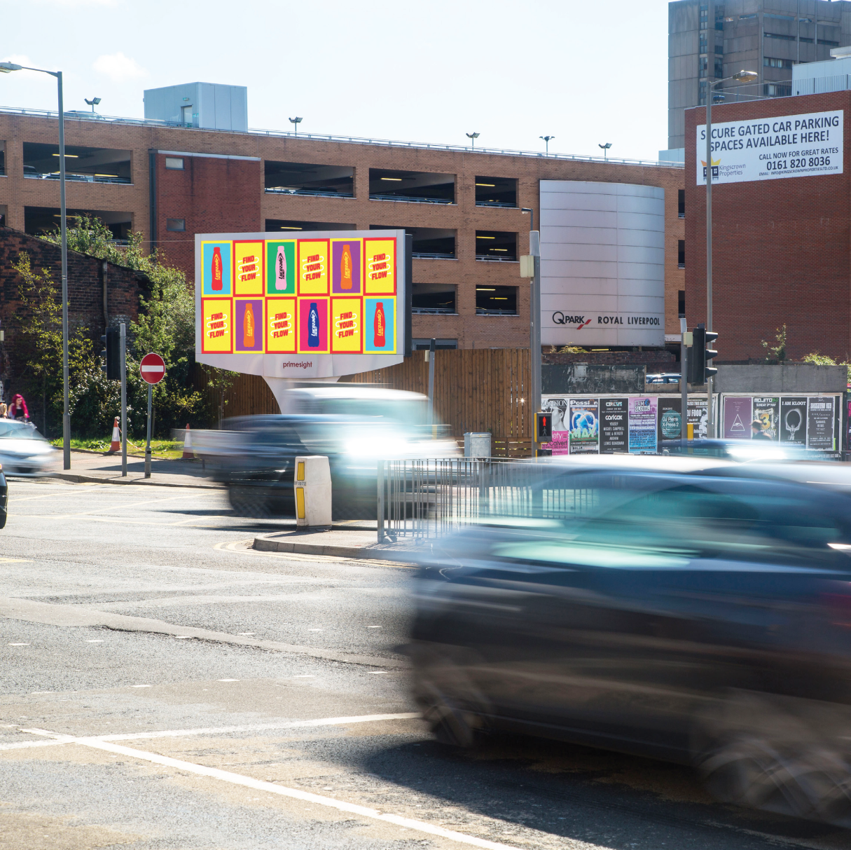
PARTNERSHIPS

Slide 13
PARTNERSHIPS
Out of Home Sync
We work with all UK DOOH suppliers to sync the timings between digital roadside 48 and 96 sheets with the corresponding radio stations. This allows you to hold up to 5-minute static on the outdoor screens, with amazing results:
79% of target audiences both seeing and hearing the advertising
63% more likely to consider purchasing as a result of this advertising
That is 37% higher than sole radio and 23% higher than sole OOH exposure
Driving Results
For the first time ever Roadside D46 & 96 sheets will carry content in the form of the localised Traffic & Travel information. Allowing advertisers, the ability to ‘own the road’ and giving you up to the minute traffic information about the journey you are currently on. Teaming this with our award-winning synced radio bulletins, Network Drive and Out of Home offer you a chance to ‘Drive Results’ for your client.
57%
Of the Population listen to radio whilst in their Vehicle
Source: RAJAR Q3 2022

Slide 14
GTN UK
3rd Floor
Sutherland House,
5-6 Argyll Street,
London
W1F 7TE
Tim McCabe – 020 3375 4771
Andy Walker – 020 3375 4772
Tom Barnes – 020 3375 4475
Andreas Ward – 020 3375 4785
Dina Kallis– 020 3375 4773
Louise O’Brien – 020 3375 4778
Selena Goh – 020 3375 4774
Email: Firstname.Surname@gtn.uk.com

