Slide 1
GLOBAL TRAFFIC NETWORK
Published Rate Card
July 2022

Slide 2
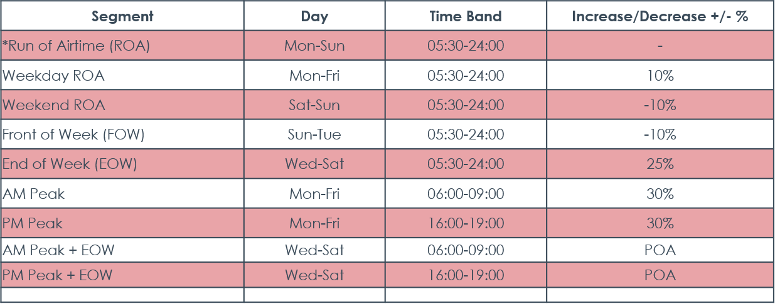
GTN UK RATE CARD 2022
*Base Rate Card set at £5.91 gross and is predicated verses the ROA Price

